Slide 1
DASC 5301-002
Random Forest
Dr Subharag Sarkar
Fall 2023
Slides Courtesy - Rózsa Záruba

Slide 2
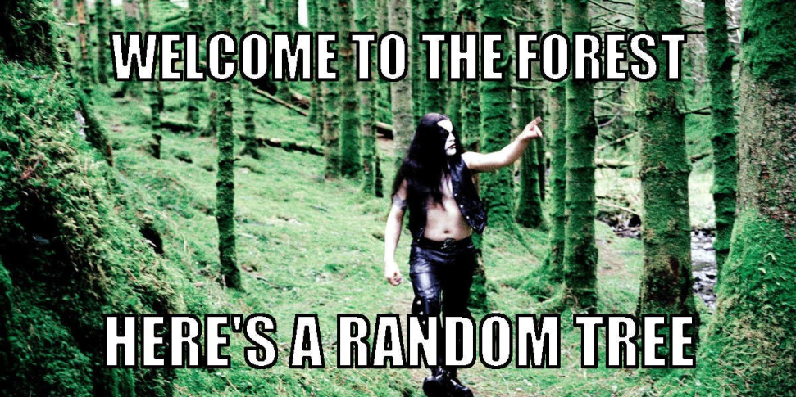
Random Forest
Random Forest is a versatile machine learning method capable of performing both regression and classification tasks.
It also undertakes dimensional reduction methods, treats missing values, outlier values, and other essential steps of data exploration, and does a fairly good job.
It is a type of ensemble learning method, where a group of weak models combine to form a powerful model.

Slide 3
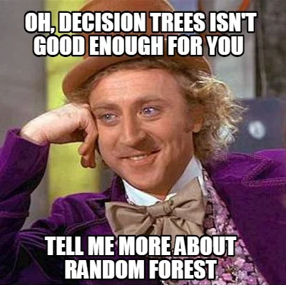
Random Forest
On a funny note, when you can’t think of any algorithm (irrespective of the situation), use random forest!

Slide 4
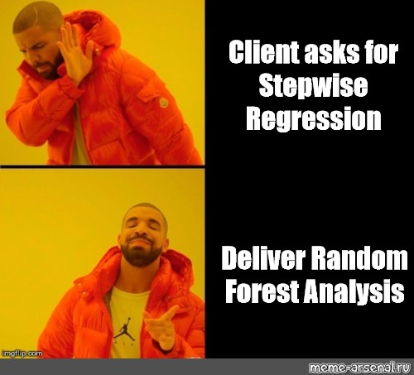
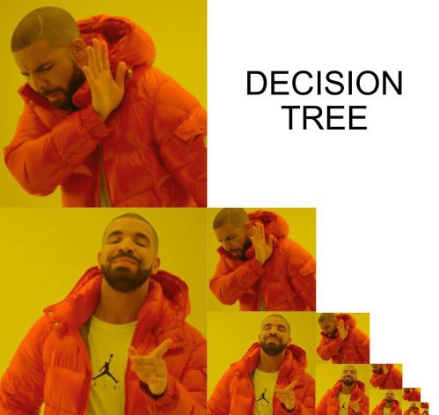

Slide 5
Random Forest
Decision trees are the Machine Learning models used to make predictions by going through each and every feature in the data set, one by one.
Random forests on the other hand are a collection of decision trees being grouped together and trained together that use random orders of the features in the given data sets.
Instead of relying on just one decision tree, the random forest takes the prediction from each and every tree and based on the majority of the votes of predictions, it gives the final output.
In other words, the random forest can be defined as a collection of multiple decision trees.

Slide 6
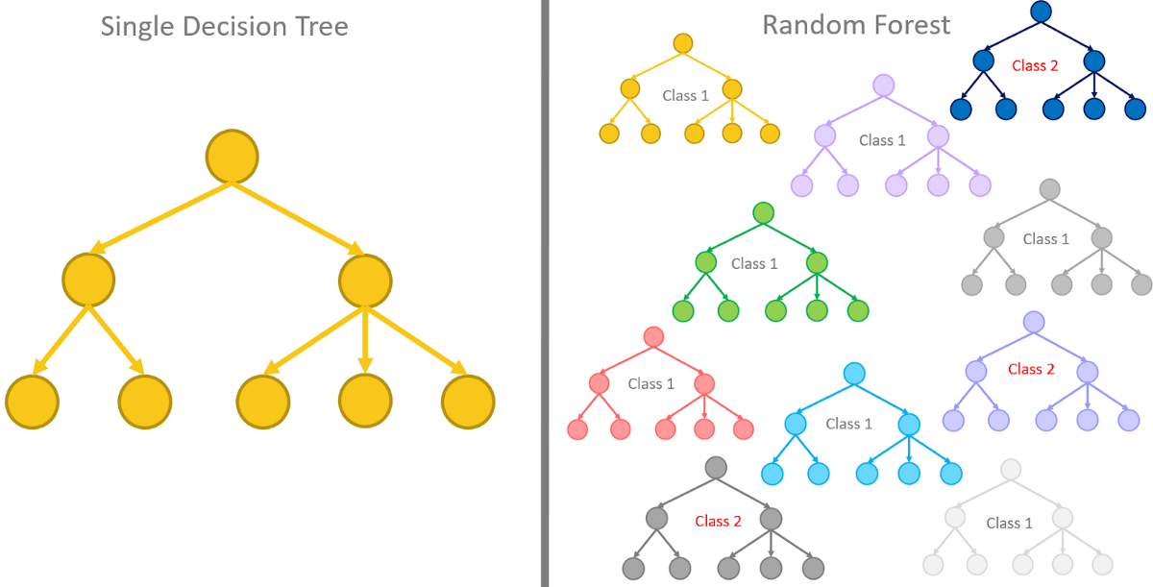
Random Forest

Slide 7
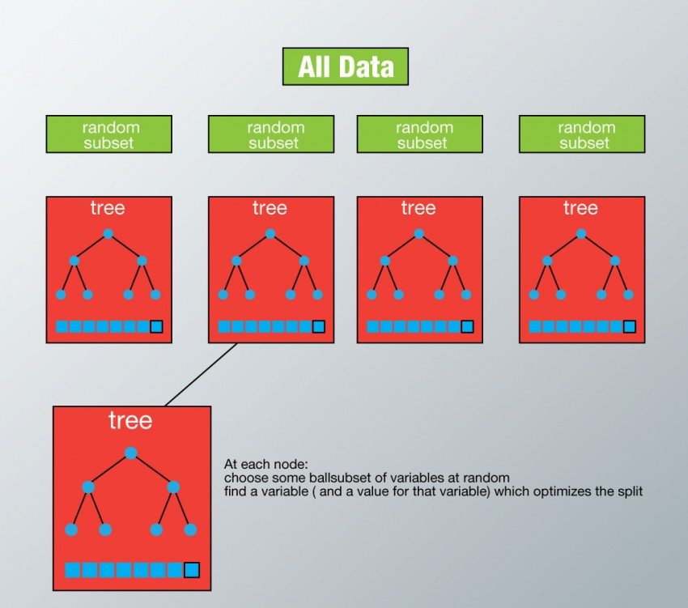
Random Forest
Assume number of cases in the training set is N.
Then, a sample of these N cases is taken at random but with replacement.
This sample will be the training set for growing the tree.
Case Study: https://www.analyticsvidhya.com/blog/2014/06/introduction-random-forest-simplified/

Slide 8
Random Forest
If there are M input variables, a number m<M is specified such that at each node, m variables are selected at random out of the M.
The best split on this m is used to split the node.
The value of m is held constant while we grow the forest.
Case Study: https://www.analyticsvidhya.com/blog/2014/06/introduction-random-forest-simplified/

Slide 9
Random Forest
Each tree is grown to the largest extent possible and there is no pruning.
Predict new data by aggregating the predictions of the ntree trees (i.e., majority votes for classification, average for regression).
Case Study: https://www.analyticsvidhya.com/blog/2014/06/introduction-random-forest-simplified/

Slide 10
Random Forest
Random Forest involves the sampling of the input data with a replacement called bootstrap sampling.
Here one-third of the data is not used for training and can be used for testing.
These are called the out-of-bag samples.
Error estimated on these out-of-bag samples is known as out-of-bag error.
Study of error estimates by out-of-bag, gives evidence to show that the out-of-bag estimate is as accurate as using a test set of the same size as the training set.
Therefore, using the out-of-bag error estimate removes the need for a set aside test set.

Slide 11
Advantages of Random Forest
This algorithm can solve both types of problems i.e. classification and regression and does a decent estimation on both fronts.
One of the benefits of Random forest is the power of handling large data sets with higher dimensionality. It can handle thousands of input variables and identify the most significant variables so it is considered as one of the dimensionality reduction methods.
Further, the model outputs the Importance of the variable, which can be a very handy feature (on some random data set).

Slide 12
Advantages of Random Forest
It has an effective method for estimating missing data and maintains accuracy when a large proportion of the data is missing.
It has methods for balancing errors in data sets where classes are imbalanced.
The capabilities of the above can be extended to unlabeled data, leading to unsupervised clustering, data views, and outlier detection.

Slide 13
Disadvantage of Random Forest
It surely does a good job at classification but not as good as for regression problems as it does not give precise continuous nature predictions.
In the case of regression, it doesn’t predict beyond the range in the training data, and they may over-fit data sets that are particularly noisy.
Random Forest can feel like a black box approach for statistical modelers – you have very little control over what the model does.
You can at best – try different parameters and random seeds!

Slide 14
Reference
https://www.analyticsvidhya.com/blog/2014/06/introduction-random-forest-simplified/
https://www.analyticsvidhya.com/blog/2021/06/understanding-random-forest/
https://www.analyticsvidhya.com/blog/2021/10/an-introduction-to-random-forest-algorithm-for-beginners/
https://www.analyticsvidhya.com/blog/2022/05/handling-missing-values-with-random-forest/
https://www.analyticsvidhya.com/blog/2023/02/how-does-random-forest-work/

